Slide 1


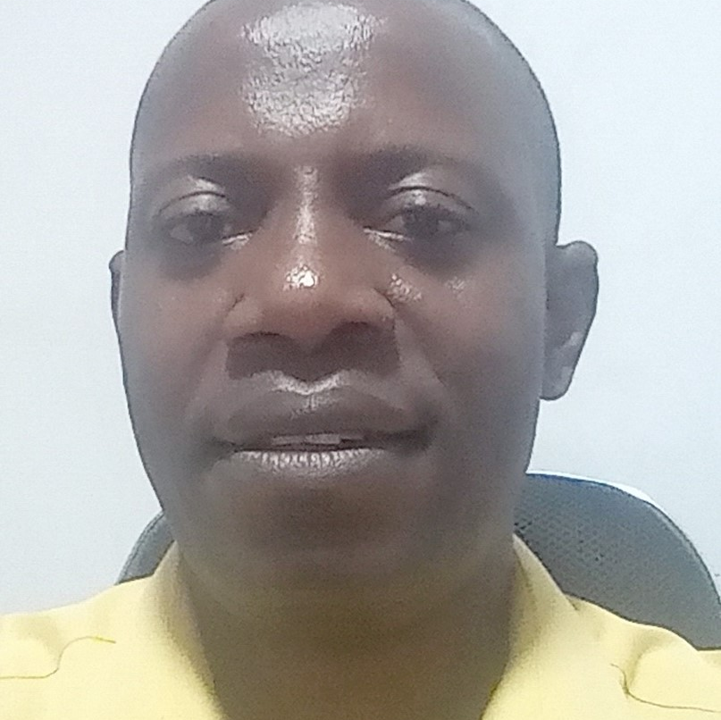
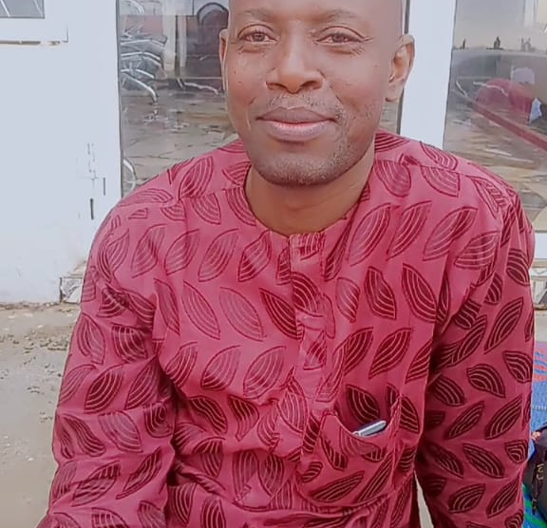
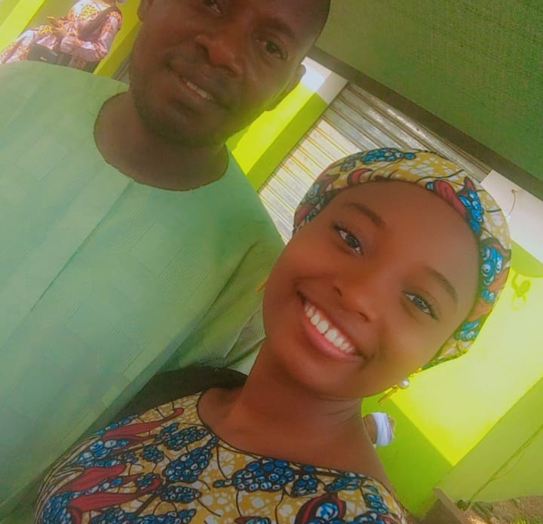
Getting to Know Me
Work
Personal
My role
Maintenance Lead
Significant others / family members / furry friends in my life
My Family members and mentors
Tenure in ofi/Olam
13 years
How I enjoy spending my free time
meeting people and staying with family
Previous companies I have worked at
Global Soaps and Detergent Nig. Ltd, Kwara State
My favorite / comfort food
Rice, Plantain and Chicken
Why I joined ofi/Olam and what keeps me here?
The Global Standard Adherence and ability to Learn new things continuously
My favorite song
Afro Hip hop
Babatunde
Jimoh
‘Jim’
Curious team player and dedicated person
This is me outside work, doing stuff I enjoy in my life …

